Slide 1


HI Feature expansion Internship application
Sheru Shafiq

Slide 2
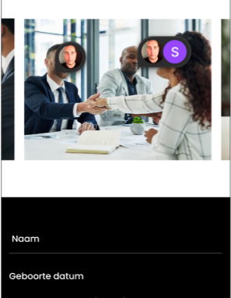
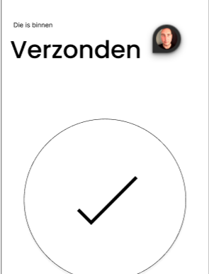
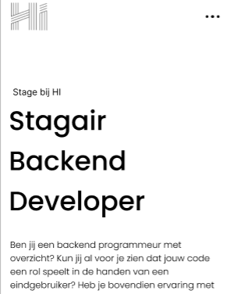
FROM DESIGN
LANDING
FORM
SENT

Slide 3
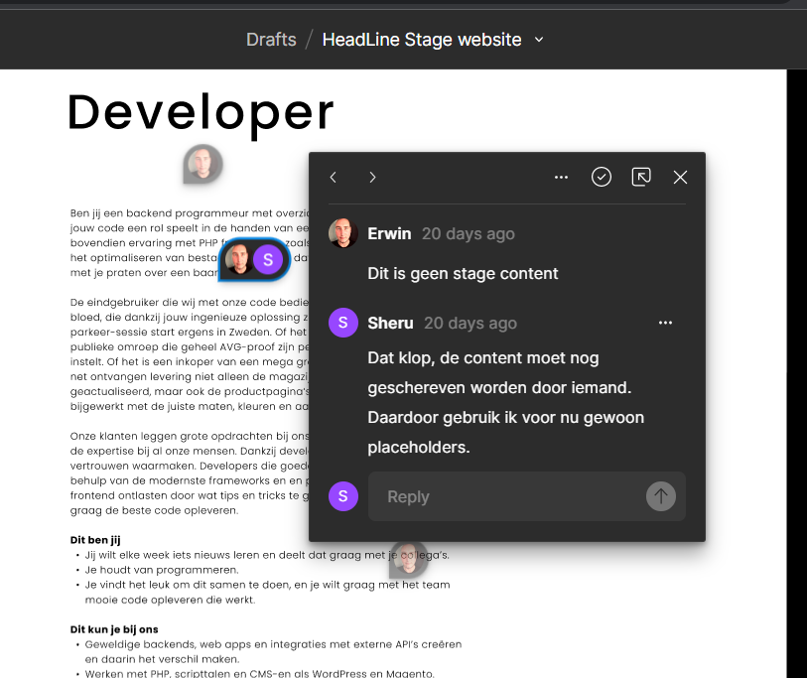
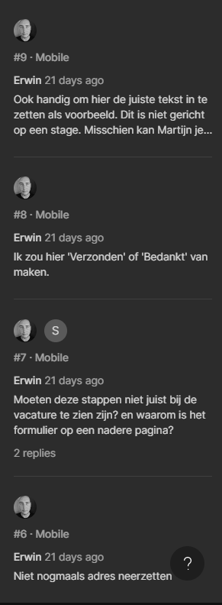
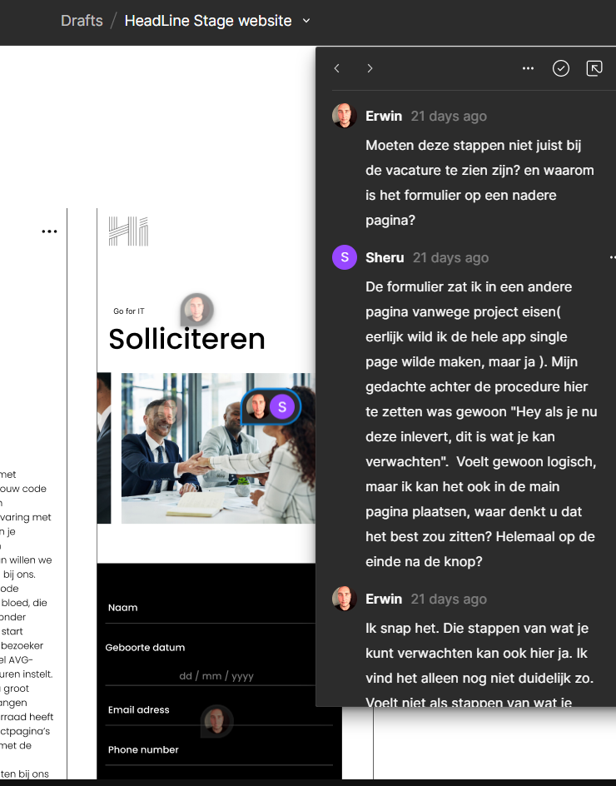
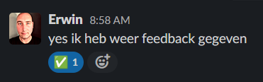
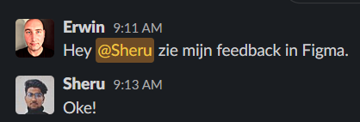

Slide 4
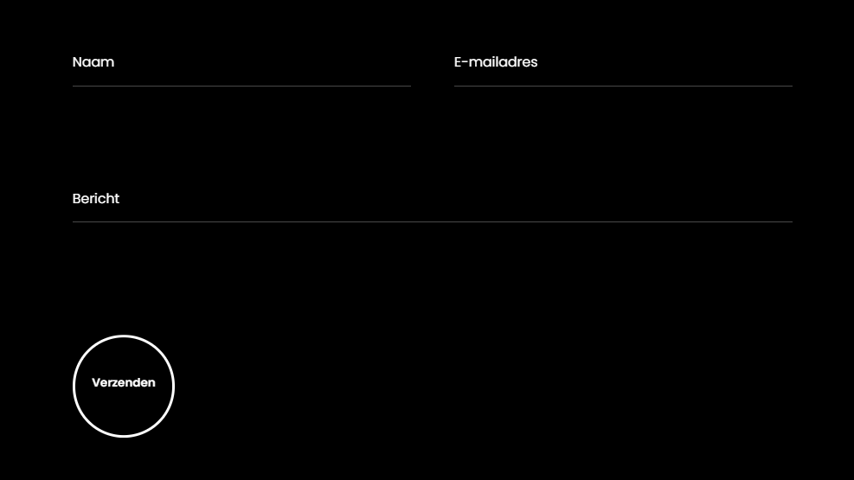
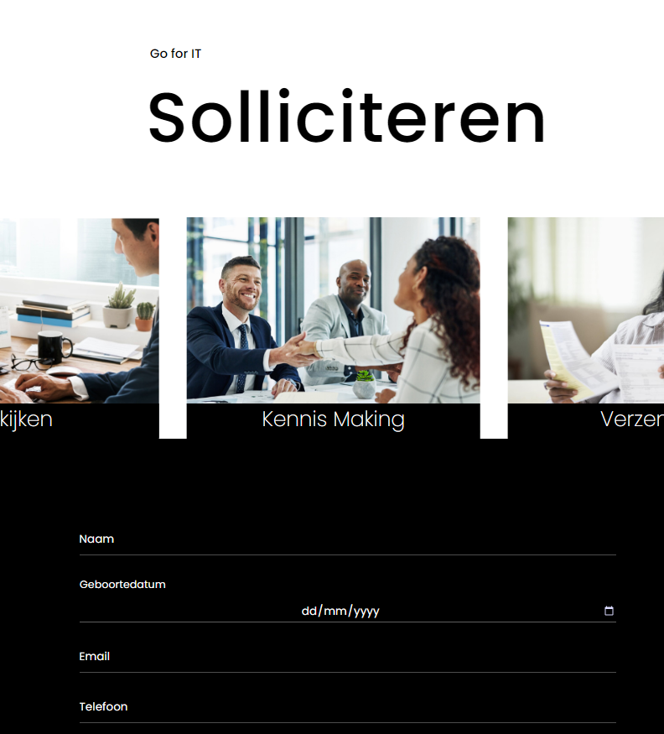
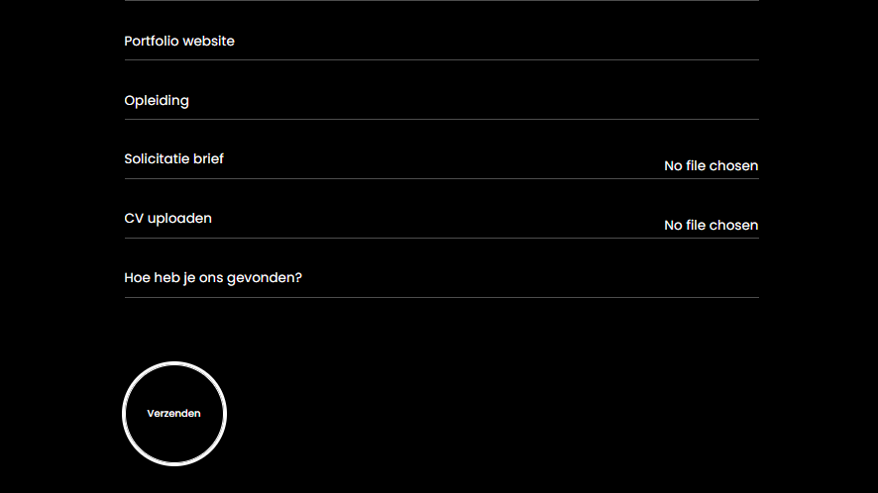
Priorities

Slide 5
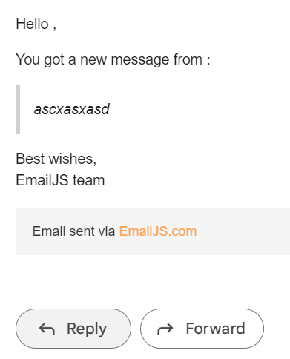
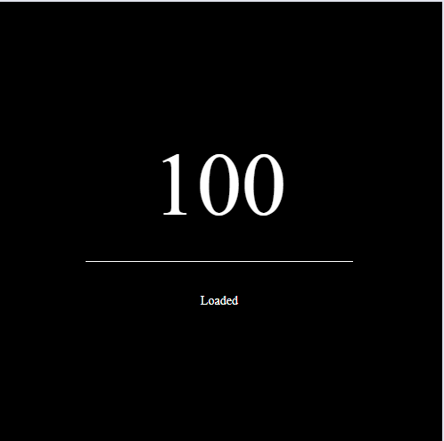
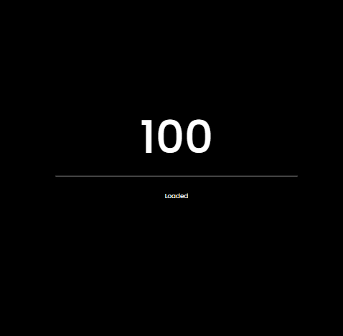
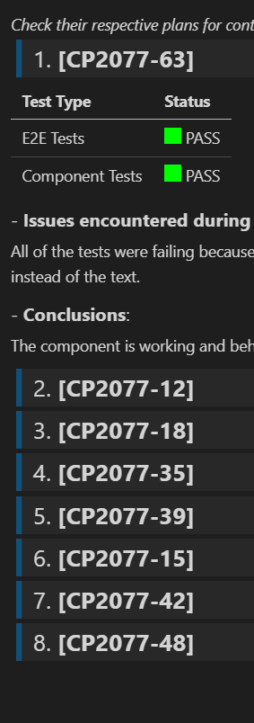
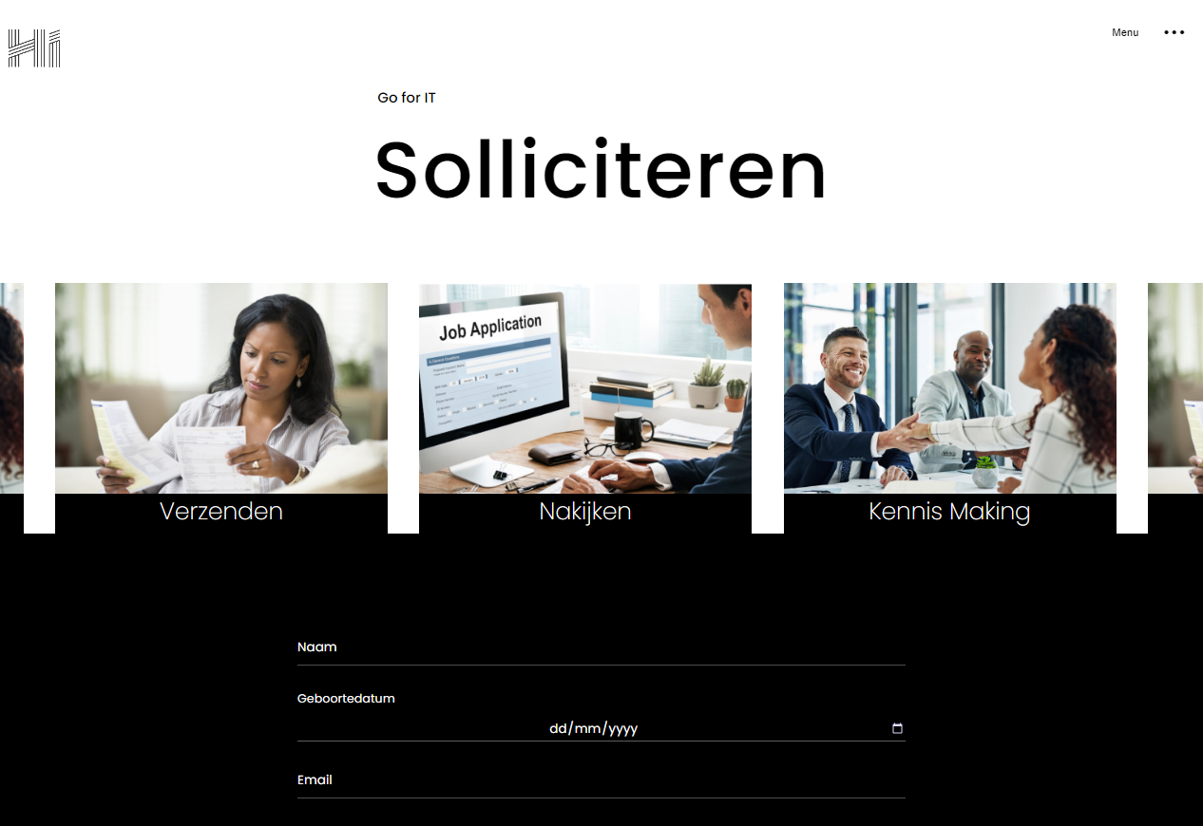
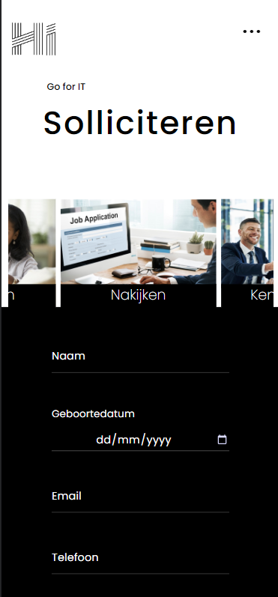
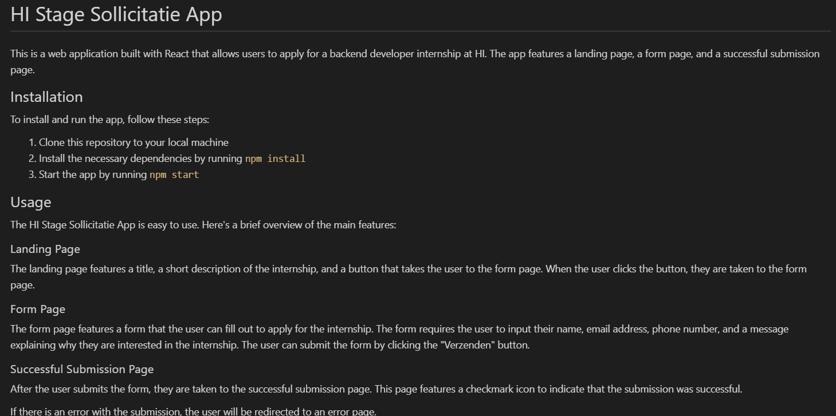
CHALENGES
API
Finding an API that matches the needs
STYLING
First beautifully designed product that's both stylish and functional
RESPONSIVE
Conducted testing with college students in the area
DOCUMENTATION
Designed with the help and input of experts in the field

Slide 6
What have I learned from the project?
Figma
How to design an app and how to receive and work out feedback from seniors.
Cypress
How to test your application
Jira
How to save time and energy by organizing every step and functionality that needs to be done and created in an industry level platform
UML
How to preplan and visualize an application

Slide 7
Have a look

Slide 8
QUESTIONS?

Slide 9
THANK YOU
Peter
Erwin
Martijn
Chris

